Slide 1
CSS 487
Computer Vision project
Carl Howing
Max Nguyen
Notes:
The presentations should be 10-15 minutes. What I want to see in the presentation is pretty much the same as the writeup. What were you trying to do? What have you accomplished (so far)? How did you do it? A demo would be nice.

Slide 2
Objectives
Face detection in real-time
Face recognition
Snapchat-like Filters using face detection
Scale the Filters to work in real time
Create Overlay using Histogram of Colors/GrayScale Values

Slide 3
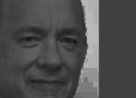
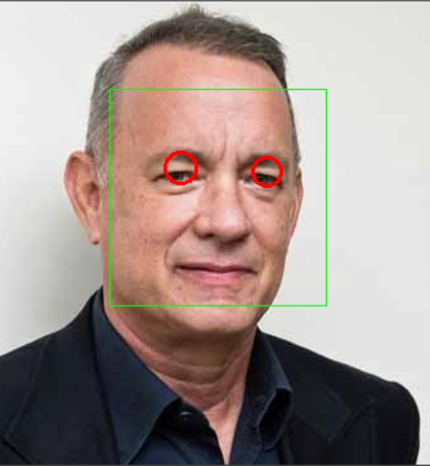
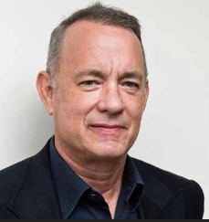
Progress so far
Face detection
Convert image to grayscale
Shrink the image
Histogram equalization
Face detection using the Haar classifier
faceCascade.detectMultiScale()
Does not work well with rotated images
Eye detection
When eyes are opened or closed
Not while wearing glasses
Issues with scaling
Notes:
Shrink the image for faster detection
Histogram equalization to improve the brightness and contrast of the image, because face detection doesn’t work well in dark conditions

Slide 4
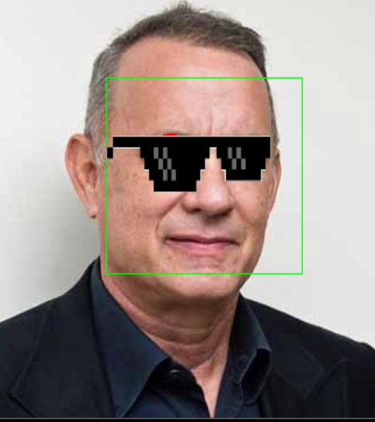
Progress so far
Snapchat-like filters
Floral headband: Real-time scale to fit the size of the head in the image
Sunglasses: Real-time scale to the position of both eyes detected
Segmentation of a Person Using Thresholding
Unreliable depending on the lighting in the room
Likely due to static thresholding
Overlay various background images
Find most common color using color histogram (Program 3)
Gaussian Blur of the background to provide privacy

Slide 5
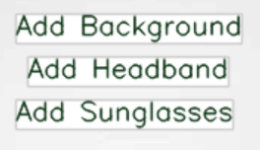
Progress so far (Cont’)
Face recognition using Eigenfaces/Fisherfaces
“The ORL Database of Faces” and CelebFaces Attributes (CelebA) Dataset
FaceRecognizer::train()
FaceRecognizer::predict()
Not implemented, because of trouble installing extra module
UI elements
Buttons for users to turn on overlays
cv::putText() and cv::getTextSize()

Slide 6
Challenges
Installing the opencv_contrib extra module
Doesn’t include face recognition as planned
Eye detection classifiers aren’t efficient enough
Detection is very unreliable
Requires face to be very close
Finding free snapchat-like filters to use
Many of them cost money
Background overlay isn’t efficient
Performance of running in real-time
Causes performance to reduce
Static images perform better.

Slide 7
Demo
Demo Zoom recording link

Slide 8
Next steps
Face/Eye Detections
Look into tweaking the parameters for eye detection.
Currently using the bounds of the face
Possibly scale the face image up to increase the detection rate
Crop the face image
Use multiple eye classifiers
Look into expanding the detection of faces that are rotated
SnapChat Filters
Find more filters to test for scaling.

Slide 9
Next steps
Segmentation of a Person to create Zoom background
Try haarcascade_upperbody classifier
Attempt to make thresholding more reliable
Utilize histogram technique
Look into more reliable segmentation techniques
K-means clustering
Super Pixels

Slide 10
Resources
Baggio, Daniel Lelis, et al. “Mastering OpenCV with Practical Computer Vision Projects.” 2012. https://www.cs.ccu.edu.tw/~damon/photo/,OpenCV/,Mastering_OpenCV.pdf

Slide 11
Thanks for listening

